Slide 1

School of Computer Engineering and Technology TY B.Tech –Mini Project Title of Project- Voice Enabled Chat GPT-3 Group No. 5 Domain of Project-AI and NLP
Names of Students with ERP nos :
Gaurav Untawale (1032201414)
Akshita Vijayvergiya (1032201451)
Priyal Agrawal (1032201406)
Durva Chawan (1032201697)
Akshat Raj (1032201725)
Project Guide : Prof. Aparna Kamble
Number of Time Students met the Project Guide : 5

Slide 2
Literature Survey
Sr No’ | Publication Title with authors [ mention whether Journal or Conference paper] | Publica-tion Year | Positive points of the Publication | Gaps in publication work
1. | Title name : Chatbot for Healthcare System Using Artificial Intelligence Authors : Lekha Athota, Vinod Kumar Shukla, Nitin Pandey,Ajay Rana Conference Paper : 2020 8th International Conference on Reliability, Infocom Technologies and Optimization | June 2020 | Proposed research introduces an AI-based chatbot system for personalized health recommendations. It aims to improve healthcare access in underserved areas with limited medical facilities, utilizing users' symptoms and medical history. The study highlights the potential of AI and chatbots in enhancing healthcare delivery and accessibility in resource-constrained settings. | Research gap: Lack of ethical and legal considerations on AI in healthcare, including privacy and informed consent. Long-term impact on patient outcomes and satisfaction needs evaluation.
2. | Title name : Voice Assistant Integrated with Chat GPT Authors : Abdulla Shafeeg, Ilman Shazhaev, Dimitry Mihaylov, Arbi Tularov, Islam Shazhaev Journal : Indonesian Journal of Computer Science Volume 12. No. 1 (2023) | February 2023 | AI chatbots, like ChatGPT with memory, offer potential in customer service, time savings, and user experience enhancement. They revolutionize business processes and everyday interactions with their efficiency and memory capabilities. | Research gap: Limited consideration of risks and challenges in widespread adoption of AI-enabled chatbots, including privacy and security concerns. Further research needed to understand and mitigate potential risks associated with their use.
3. | Title name : FaceChat: An Emotion-Aware Face-to-face Dialogue Framework Authors : Alnuhait, D., Wu, Q., & Yu, Z. Journal : arXiv preprint arXiv:2303.07316 | Mar 2023 | This paper presents an innovative approach to improve human-human communication via emotion detection and response. It includes a clear methodology with detailed dataset, feature extraction, model architecture, and evaluation metrics. Experiments demonstrate the framework's applicability to real-world scenarios, with comprehensive result discussions and future research directions. Significant contribution to emotion-aware dialogue frameworks. | Research gap: No direct comparison of proposed framework with existing emotion-aware dialogue frameworks in literature. Comparative analysis could reveal strengths, weaknesses, and areas for improvement, aiding in further research.

Slide 3
Problem Statement
Create voice-controlled interface for Chat-GPT3 to improve user experience, accessibility, and broaden applications.
The problem statement is to develop a voice-controlled interface for the Chat-GPT3 language model, which is currently only accessible through text input. The goal is to provide a more convenient and natural way for users to interact with the Chat-GPT3 model, allowing them to speak their questions and receive responses through voice commands.

Slide 4
Requirements Gathering
Software requirements:
Python: You need to have Python installed on your computer.
Whisper API:You will need to sign up for a Whisper API key, which also requires creating an account and being approved by the provider. Once you have the API key, you can use it to make API requests to Whisper
OpenAi API:You will need to sign up for an OpenAI API key, which requires creating an account and being approved by OpenAI. Once you have the API key, you can use it to make API requests to OpenAI.
pyttsx 3: You need to install the pyttsx3 library to use it for text-to-speech.
Network connection: You will need a stable network connection to make API requests to OpenAI and Whisper API. Make sure to test your project in different network conditions to ensure it works properly.
Django: You need to install Django to create a web application.
Heroku CLI: You will need the Heroku Command Line Interface (CLI) to deploy your Django web application on Heroku.

Slide 5
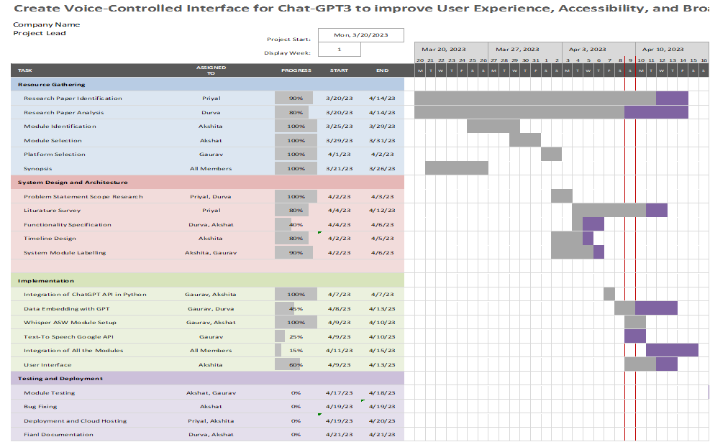
Project Timeline Diagram
Link for the Timeline Diagram
https://1drv.ms/x/s!AoE-tOtyR5U9jGJdSZ8HbPqli8u6

Slide 6
System Design
Module 1: Language Setup
Speech Recognition: Converts spoken commands into text input for the language model.
Google Text-to-Speech: Converts generated text responses into natural-sounding speech output.
Module 2: API Interfacing and User Interface
Chat-GPT3 and Whisper ASW API/Interface: Facilitates interaction with the Chat-GPT3 API or interface for text inputs and outputs.
User Interface and Designing: Provides a user-friendly interface for voice commands, audio responses, and user input.
Module 3: Cloud Deployment
Cloud-Based Hosting: Hosts the system on a cloud-based infrastructure for accessibility and efficient processing.
Module 4: Data Analysis and Embedding
Scalability and Performance: Ensures scalability and optimized system performance for real-time responsiveness and a seamless user experience. Real-time data incorporation is also taken into account.
Data Analysis and Data Encoding: Training ChatGPT with the data
Module 5: Implementation

Slide 7
System Design - Module 1: Language Setup
Language setup is a crucial part of this project as both input and output is in speech format. it has 2 parts: 1. Speech to text Conversion
Audio Input: The system would need a way to receive audio input, such as through a microphone, and pass it to the speech recognition component.
Whisper API Integration: The Whisper API would be integrated into the system to perform the speech recognition. The audio input would be passed to the Whisper API, which would convert it to text.
Natural Language Processing: After the text is generated, natural language processing techniques could be used to analyze the text and extract information.
Information Extraction: The extracted information could be used to perform some action, such as providing an answer to a user's query, or to trigger a follow-up action.

Slide 8
System Design - Module 1: Language Setup
2. Text to speech conversion:
Text Input: The system would receive text input from the user or another system.
Google API Integration: The Google API would be integrated into the system to perform the text-to-speech conversion. The text input would be passed to the Google API, which would generate an audio output file.
Audio Output: The audio output file would be played through the system's audio output, such as speakers or headphones.
Voice Selection: The system could allow the user to select the desired voice for the text-to-speech conversion, or it could automatically select a voice based on the user's preferences or the context of the text.

Slide 9
System Design - Module 2: ChatGPT system and Integration
Attention module is a crucial component used in Chat-GPT, a language model that uses the transformer architecture.
Attention Mechanism: It allows the model to focus on different parts of the input sequence with varying weights, giving more importance to relevant information.
Multi-Head Attention: Chat-GPT typically uses multi-head attention, where multiple attention heads are utilized to capture different aspects of the input.
Information Fusion: The attention module helps in aggregating information from different parts of the input sequence, enabling the model to generate more accurate and contextually relevant responses.
Enhancing Model Performance: The attention module aids in improving the model's ability to understand complex relationships and dependencies within the input data, resulting in higher quality responses in a chat-based conversation.

Slide 10
System Design - Module 2: User Interface
The webpage design will be built using Django/Gradio, which is a Python web framework that allows for rapid development of web applications.
Design Considerations: The webpage design will focus on creating an interactive and user-friendly interface for the intended purpose of the project.
Responsive Design: The webpage will be designed to be responsive, ensuring that it adapts well to different screen sizes and devices, such as desktops, tablets, and mobile devices.
Navigation and Layout: The webpage will have a clear and intuitive navigation system, with a well-organized layout that includes headings, subheadings, and sections for easy access to information.
Color Scheme and Typography: Appropriate color schemes and typography will be chosen to create a visually pleasing and cohesive design.
Interactive Features: The webpage may include interactive features, such as buttons, forms, and interactive widgets, to engage users and provide a seamless experience.
Accessibility: The webpage design will adhere to web accessibility guidelines, ensuring that it is accessible to users with disabilities.

Slide 11
System Design - Module 3: Cloud Deployment
Deploying Chat-GPT3 with Voice Command Capabilities on Heroku Cloud:
Development of Local Interface: Develop the voice-controlled interface locally.
Heroku Account Setup: Create a Heroku account and install the Heroku CLI.
Repository Connection: Connect the local repository to the Heroku app.
Code Deployment: Push the application code to Heroku using Git and set up necessary configurations.
Testing and Deployment: Test the application and deploy it on Heroku, ensuring scalability and ability to handle traffic spikes.
Heroku for Web Application Hosting: Heroku is an ideal platform for hosting web applications due to its scalability and reliability.
Public Access: Once deployed, users can access the voice-controlled interface through the public URL provided by Heroku.

Slide 12
System Design - Module 4: Data Analysis and Embedding Methods
Data Analysis and Embedding Methods incorporated into Voice-GPT:
Training Data: Voice-GPT is trained on a diverse range of text data from the internet, including books, articles, websites, and other sources to learn language patterns, grammar, and context.
Data Embedded via API: Data is embedded into Voice-GPT through the API, which provides accurate responses generated based on user input.
Data Limitation: Voice-GPT's training data is current until September 2021 and may not include the latest information.
Incorporating Latest Data: Future plans include incorporating information from web scraping in the domain of Geopolitics for self-awareness and updating Voice-GPT with the latest data.
Data Privacy and Compliance: Data embedding into Voice-GPT should comply with relevant data privacy and security regulations to ensure user privacy and data protection.

Slide 13
System Design - Module 5: Implementation
Data Embedding into the ChatGPT:
Prepare the data: Gather and prepare the data, such as text or images, depending on ChatGPT's capabilities.
Encode the data: Convert the data into a format that ChatGPT can understand, using techniques like tokenization or numerical representations, making it a Question/Answer Pair.
Integrate the data: Append the encoded data as additional inputs to the chat conversation to become part of the context used by ChatGPT.
Train the model: Fine-tune ChatGPT with the embedded data by feeding it as input during the training process.
Utilize the embedded data: Once the model is trained, provide the embedded data during inference to generate responses informed by the embedded data.

Slide 14
Future Aspects
We have made the primary model to help users in English Language audio support for chat GPT but plan to extend the same features in a more accurate conversion for different local as well as global languages.
For first trimester of deploying website Testing can be done by giving free to limited students with visual impairments. We will be deploying our website on Heroku a deploying platform. this system will be accurate for Speech in English language to Text.
We also plan to expand the whole model into a Chrome extension so as to help users to apply our model on different websites and other applications. also incorporating latest information after september 2021 about any specific domain such as Geopolitics and self awareness.
Our major goal is to make the whole product more accessible and efficient for people with Physical or Visual Difficulties.

Slide 15
Publication details
Details on Literature Review Paper
In our research, we have reviewed various papers related to the topic of voice GPT: the audio support for ChatGPT. We have studied existing literature to understand the current state of research in this area.
Based on our findings, we are in the process of writing our own research paper titled “Create voice-controlled interface for Chat-GPT3 to improve user experience, accessibility, and broaden applications.”.
We are planning to publish this paper to share our findings and contribute to the existing body of knowledge on this topic.
We critically reviewed and synthesized relevant published works, such as journal articles, conference papers, books, and other reputable sources, to identify the current state of knowledge and gaps in the field.
Details of Future planning for Implementation Paper
We have reviewed various papers and are currently developing a model for voice-enabled ChatGPT, which we have named “Create voice-controlled interface for Chat-GPT3 to improve user experience, accessibility, and broaden applications.”.
As part of our research, we are in the process of writing a research paper that describes our findings and insights. We plan to publish this paper in the near future to share our work with the academic community and contribute to the field of voice-based natural language processing.

Slide 16
Thank you Slide

